Slide 1

Final Year Project
Three Stage Pipeline ALU Processor
Vadan Shah(210280111024)
Darshil Bhavsar(210280111038)
L.D COLLEGE OF ENGINEERING Department:-Electronics And Communication

Slide 2

Let’s Discuss !
1) Why go for Pipeline Architecture?
2) How to do that !
3) Is it useful ?

Slide 3
About Project:-
The 3-Stage Pipelined ALU Processor designed in this project successfully demonstrates the principles of pipelined processing for efficient arithmetic and logical operations. By implementing a pipeline architecture, the processor achieves improved instruction throughput while maintaining efficient resource utilization. The integration of fundamental arithmetic operations such as addition, subtraction, multiplication, and division ensures a well-rounded functionality suitable for embedded and FPGA-based applications.

Slide 4
Additionally, the Restoring Division Algorithm was chosen for integer division due to its hardware-friendly nature and ease of implementation on the Spartan-6 FPGA. The FPGA’s configurable logic blocks (CLBs) and DSP slices enable an efficient hardware mapping of the arithmetic operations, ensuring smooth execution of ALU functions.
Overall, the developed pipelined ALU processor on the Xilinx Spartan-6 FPGA serves as a strong foundation for further enhancements in digital arithmetic units. It highlights the advantages of pipelined processing, FPGA-based computation, and efficient arithmetic logic design, making it a valuable contribution to the field of digital system design and FPGA-based computing architectures.

Slide 5
🔄 Throughput :- In simple words “More Instructions per Time”
Without pipelining: You finish 1 instruction at a time.
With pipelining: You can start a new instruction every clock cycle, so you finish more instructions in less time.
🧠 Think of it like washing, drying, folding clothes — if one person does it all, it’s slow. But with 3 people doing one stage each, the work overlaps and finishes faster.
🔧 Better Utilization of Hardware Resources
📚 Scalability
⚡ Faster Execution
So Pipelining increases the instruction throughput of a processor by allowing multiple instructions to be processed at different stages simultaneously. It’s a must-have technique in modern CPU design to achieve speed and efficiency.

Slide 6
1. Arithmetic Logic Unit (ALU) Design
An ALU is a critical component of any processor, responsible for performing arithmetic (addition, subtraction, multiplication, etc.) and logical (AND, OR, XOR, etc.) operations. Traditional ALU designs operate sequentially, limiting execution speed, whereas modern approaches integrate parallel processing and pipelining to increase throughput. Research has demonstrated that pipelined ALUs significantly improve performance by allowing multiple operations to be processed in different pipeline stages simultaneously.

Slide 7
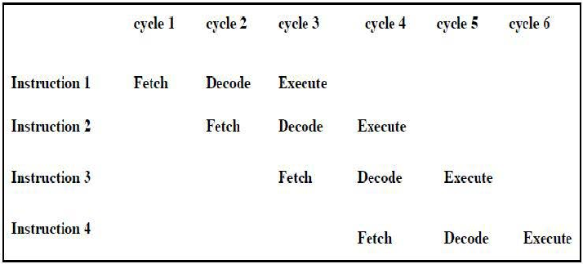
2. Pipelining in Processor Architecture
Pipelining is a well-established technique in processor design that enhances execution efficiency by dividing tasks into smaller stages, allowing them to be executed in parallel. Studies indicate that a 3-stage pipeline (Fetch, Decode, Execute) balances complexity and performance, making it suitable for resource-constrained environments such as embedded systems.

Slide 8
3. FPGA-Based ALU Implementation
FPGAs provide a flexible and high-performance platform for implementing digital circuits due to their parallelism, reconfigurability, and real-time execution capabilities. Prior research has explored FPGA-based ALU designs, demonstrating their advantages in terms of reduced power consumption, high-speed computation, and adaptability. Many studies highlight the use of Verilog/VHDL for ALU implementation, utilizing FPGA resources such as Look-Up Tables (LUTs) and DSP blocks for efficient computation.

Slide 9
METHODOLOGY
The entire design is implemented by the following steps in progression.
1)To Design simple fixed point ALU
2)To make Multiplication and Division using Computer Algorithms
3)Understanding a Processor for 3 stage pipeline
4)Adding different modules of processor supporting ALU
5)Driving 3 stage Pipeline

Slide 10
Pipeline:-
In the context of embedded systems, pipelining refers to a technique that breaks down instruction execution into stages, allowing multiple instructions to be in various stages of execution simultaneously. This parallel processing approach significantly enhances the efficiency of processing instructions, resulting in higher throughput and faster program execution.
There Are Three Stages:-
Fetch
Decode
Execute

Slide 11
1)Fetch (IF - Instruction Fetch):-
Description: In this stage, the ARM7 processor fetches the instruction from memory (typically from the instruction cache or main memory) using the current Program Counter (PC). This step involves reading the instruction and preparing it for decoding.
Key Tasks:
1)The instruction located at the address specified by the Program Counter (PC) is fetched from memory.
2)The PC is incremented to point to the next instruction (or updated in the case of branch instructions).

Slide 12
2)Decode (ID - Instruction Decode):-
Description: After the instruction is fetched, the ARM7 processor decodes it to determine what action needs to be taken. This stage involves decoding the instruction's operands and determining the type of operation (e.g., arithmetic, load/store, branch).
Key Tasks:
1)The instruction is decoded into its components (e.g., opcode, registers, and immediate values).
2)The necessary operands (values) for the instruction are fetched from the registers or memory.
3)The control logic prepares the pipeline for the execution stage based on the instruction type (e.g., setting flags for condition codes, determining whether the instruction requires a read/write to memory).

Slide 13
3) Execute (EX - Execution):-
Description: In the final stage, the ARM7 executes the instruction. The actual operation specified by the decoded instruction is carried out, such as performing arithmetic, loading/storing data from/to memory, or branching.
Key Tasks:
1)For arithmetic and logical instructions, the ALU (Arithmetic Logic Unit) performs the operation.
2)For load and store instructions, data is transferred between registers and memory.
3)For branch instructions, the Program Counter (PC) is updated to a new value based on the branch condition.

Slide 14
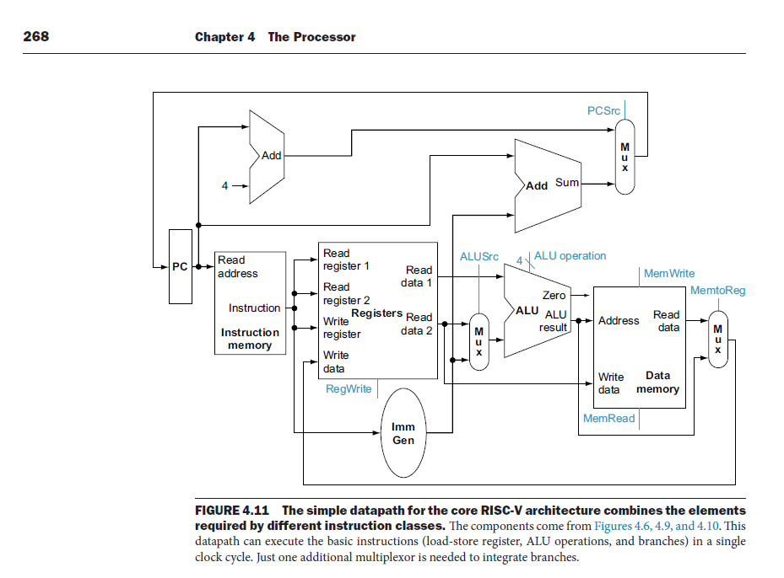
Computer Architecture and Design RISC-V Addition –Morgan Kaupmann

Slide 15
Processor Architecture Overview
Diagram: Block diagram showing the 3-stage pipeline: IF, ID, EX.
Components:
Program Counter (PC)
Instruction Memory
Control Unit
Register File
ALU
Pipeline Registers (IF/ID, ID/EX, EX/WB)
Write Back Unit
OPCODE (15:12) | Rd (11:9) | Rs1 (8:6) | Rs2 (5:3) | NOP etc…

Slide 16
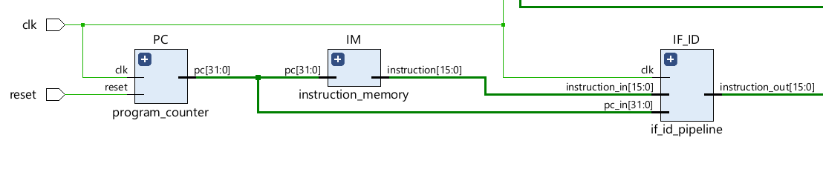
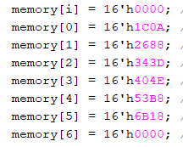

Slide 17
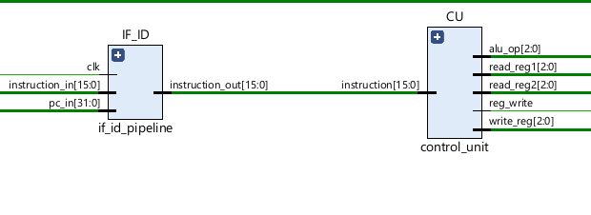
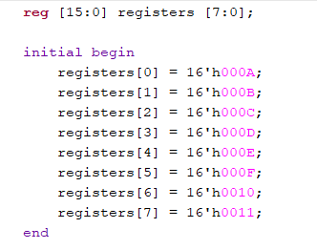
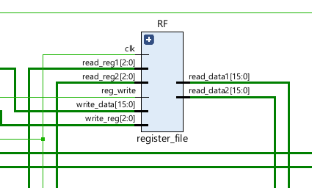

Slide 18
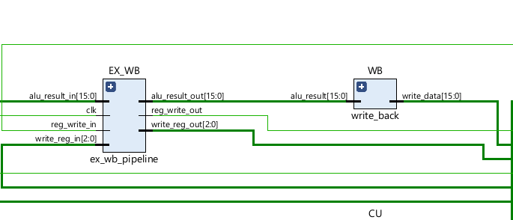
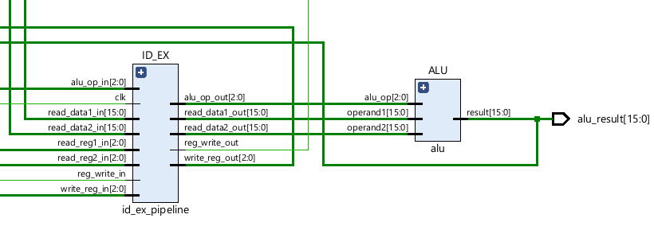
Booth Algorithm
Restoring Algorithm

Slide 19
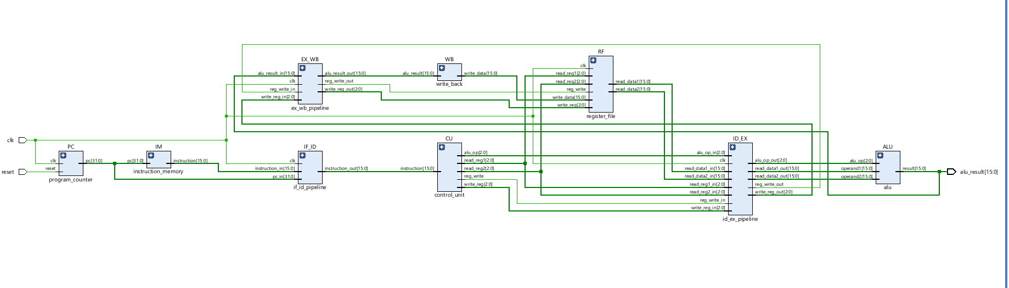

Slide 20
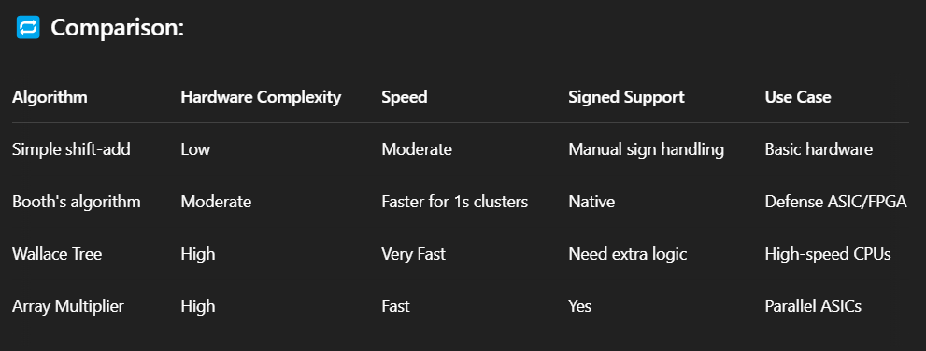
✅ Reason for Using Booth's Algorithm:
Booth's algorithm handles signed multiplication efficiently and reduces the number of add/sub cycles required in some cases. It scans two bits at a time, enabling faster execution for certain data patterns (e.g., sequences of 1’s).
🆚 Simple Multiplication Logic:
Simple logic (like shift-and-add) performs a multiplication by repeatedly adding the multiplicand for every bit that is 1 in the multiplier, taking N cycles for N-bit numbers.
But what is importance of signed number ?

Slide 21
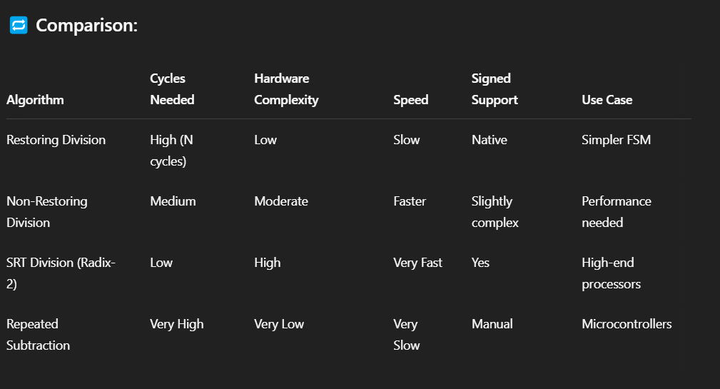
✅ Reason for Using Restoring Division:
You’re implementing signed division using an approach that closely resembles how actual CPU ALUs work. Restoring division is easier to implement in sequential logic and is easier to debug in hardware.
🆚 Simple Division Logic:
Simple division might use repeated subtraction or rely on high-level operators (/). While okay in software, they’re hard to synthesize or inefficient in hardware.

Slide 22
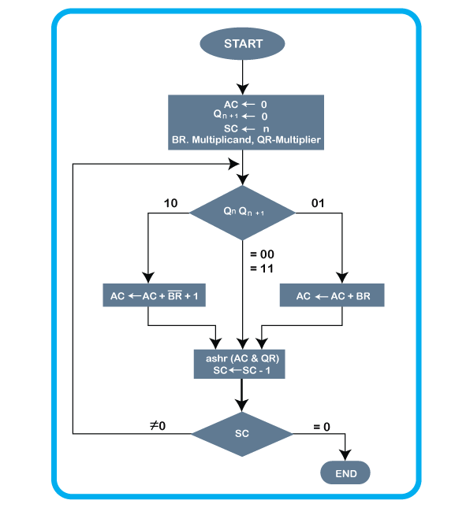
How Booth Algorithm and Restoring Algorithm Works:-

Slide 23
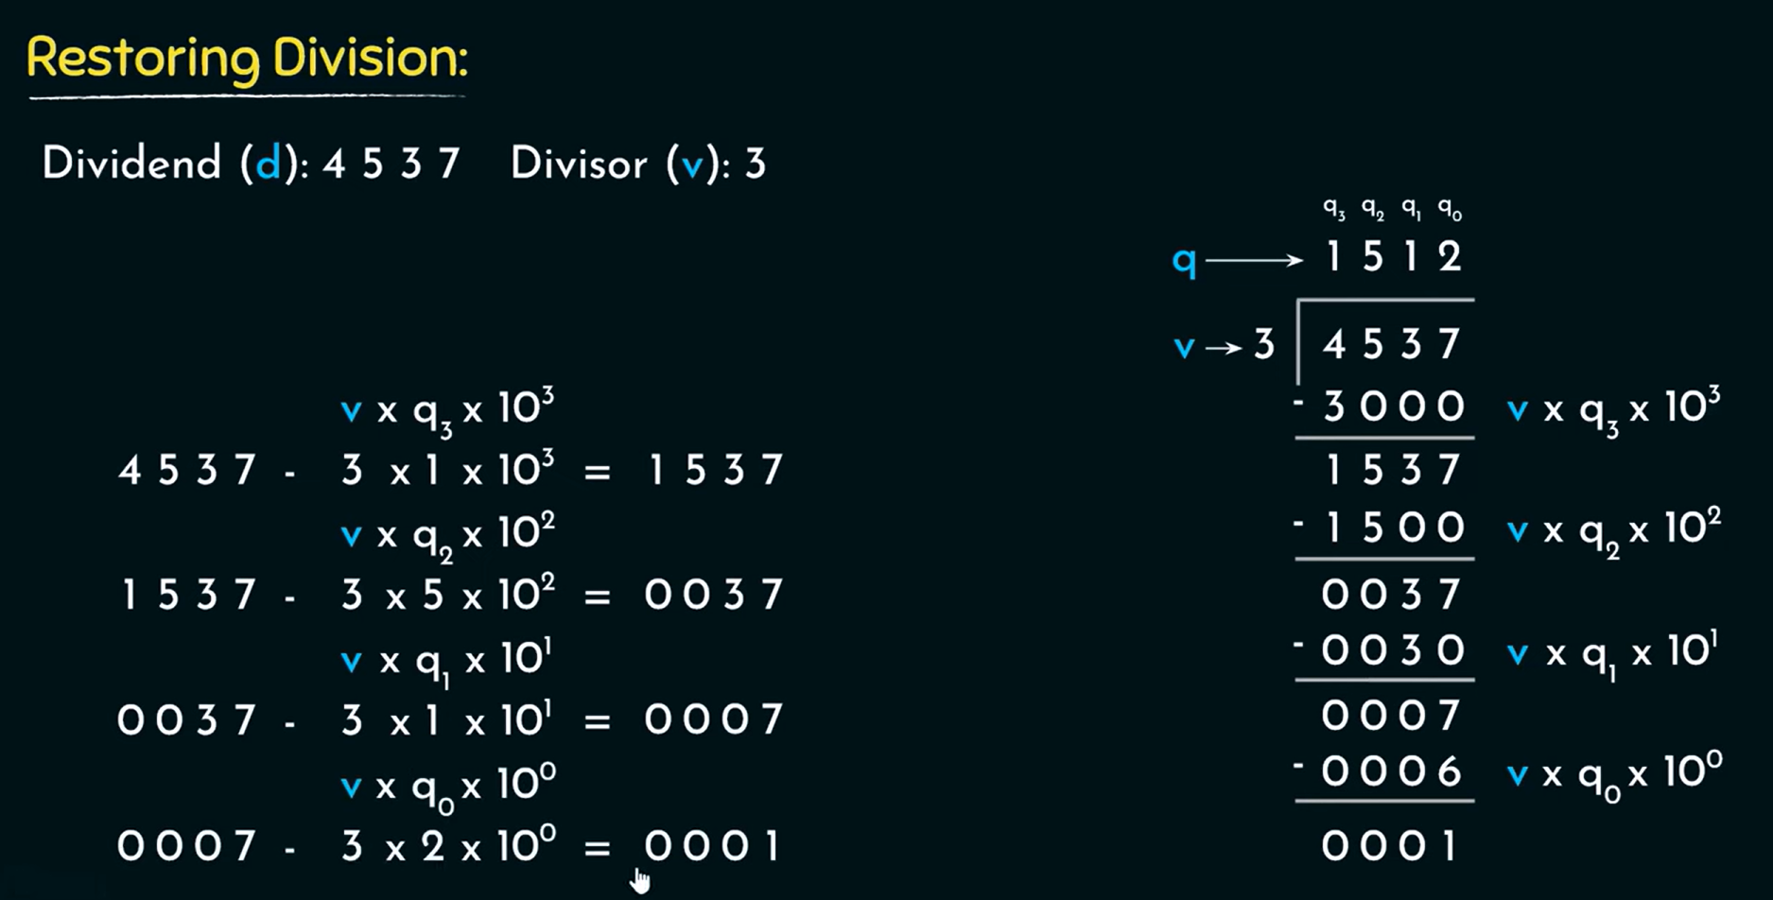
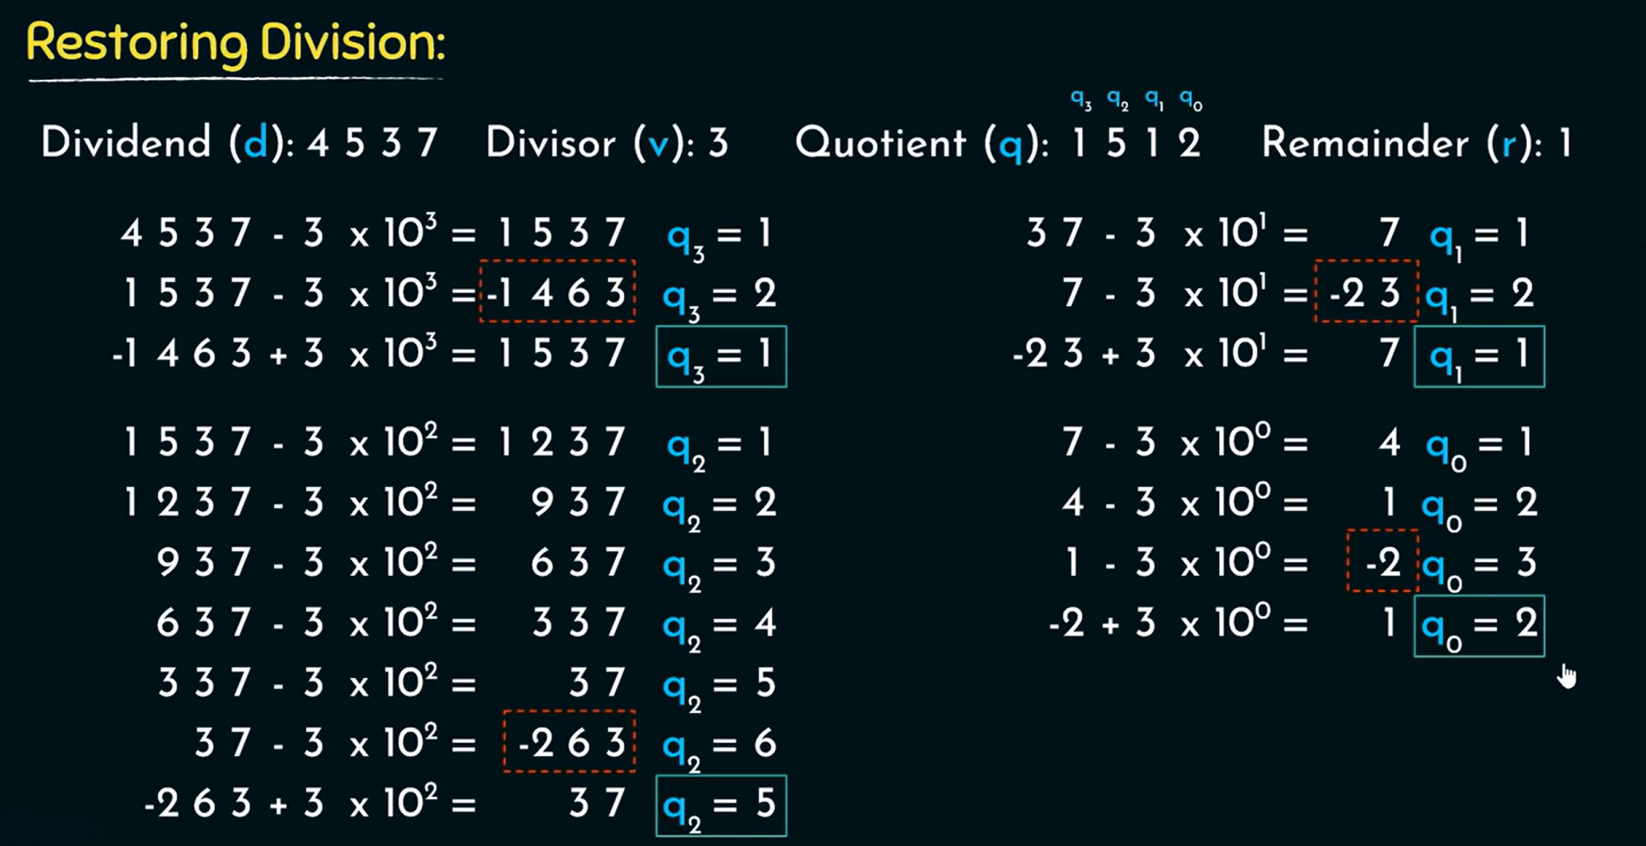

Slide 24
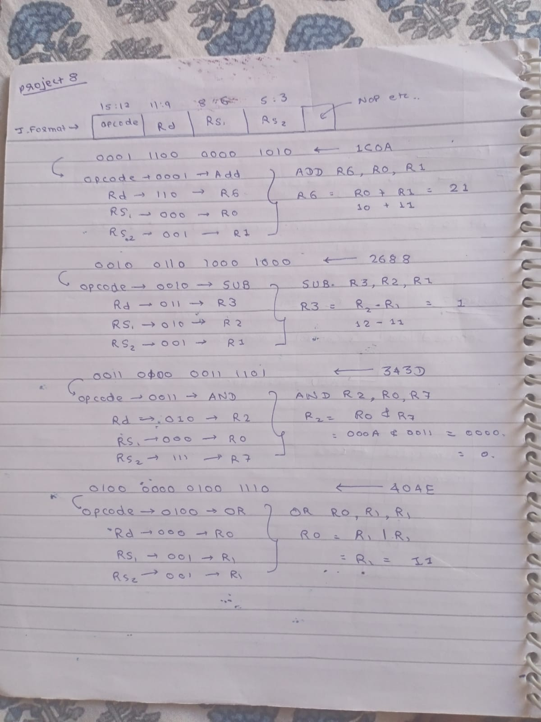

Slide 25
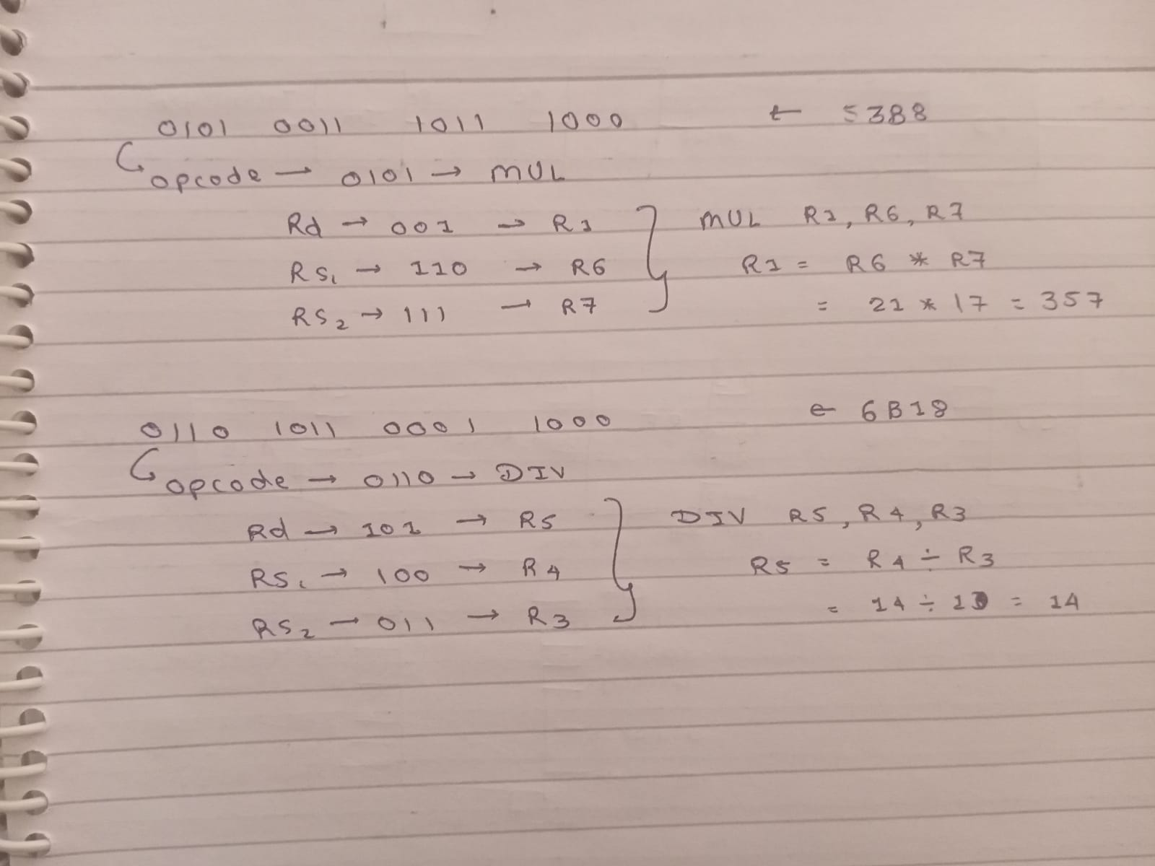

Slide 26
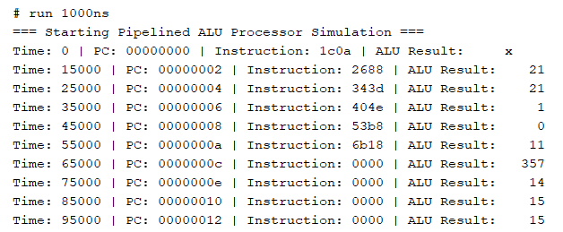
Results:-

Slide 27


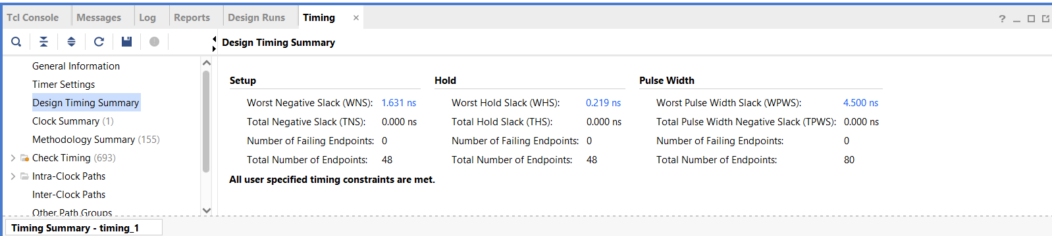
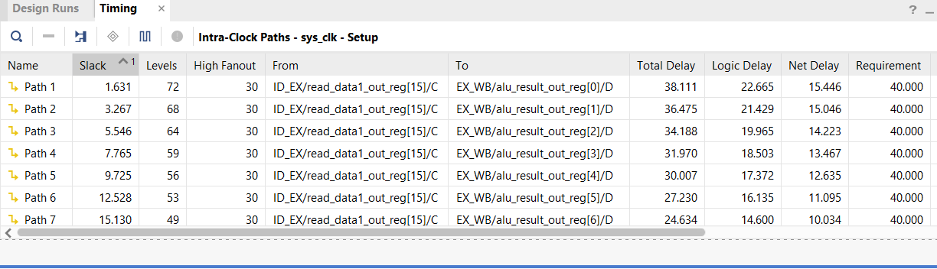
Timing Reports:-

Slide 28
